Slide 1
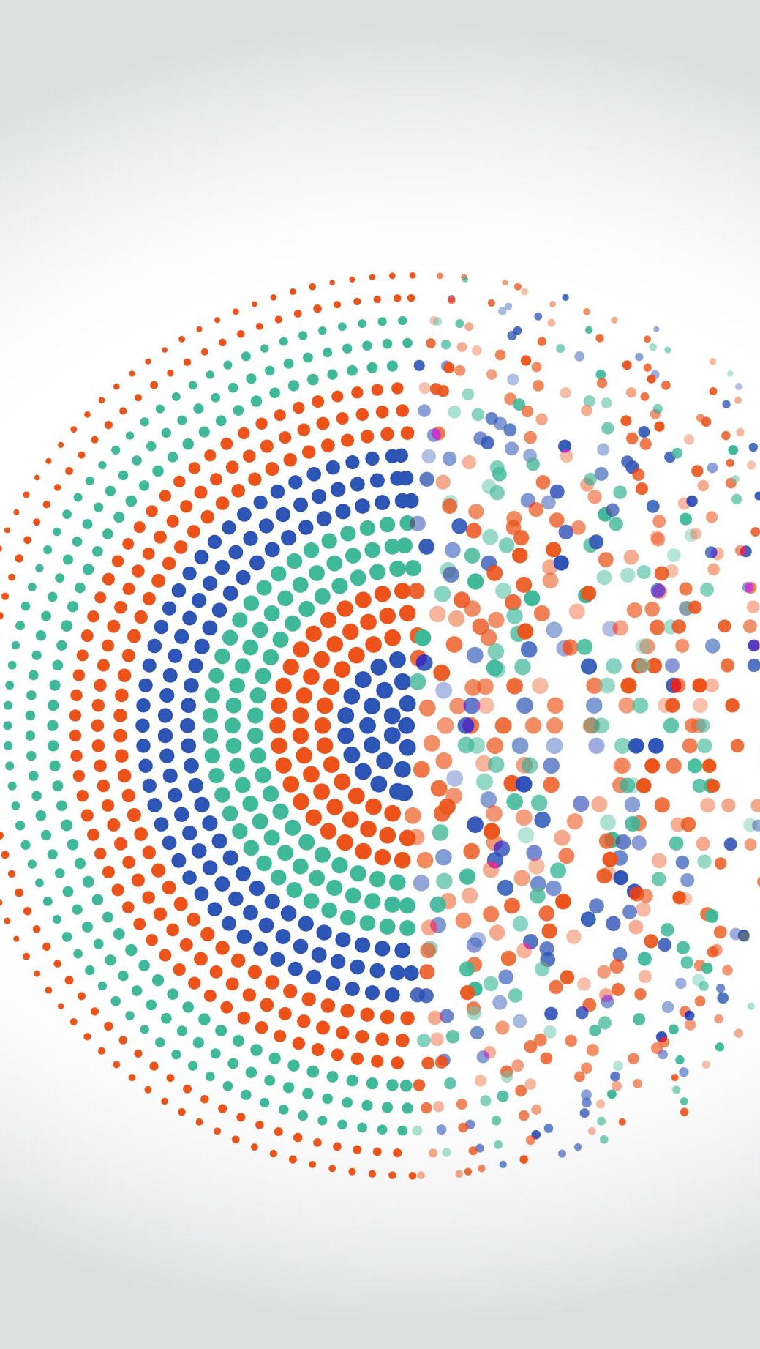
Pattern Recognition: Project Sign Language Prediction using Gesture Recognition
Computer Vision and Machine Learning
Swasthik Muloor

Slide 2
Introduction
Sign language is vital for individuals with hearing and speech impairments as their primary means of communication.
It enables them to express emotions, thoughts, and ideas, and facilitates interaction with others
Sign language is a complex and rich form of communication, with its own grammar, syntax, and vocabulary.
Understanding and interpreting sign language can be challenging for those who are not familiar with it.

Slide 3
Problem Statement:
Develop a real-time sign language detection system that can accurately recognize and interpret American Sign Language (ASL) gestures. The system should be able to translate these gestures into text, enabling individuals with hearing impairments to communicate more effectively with others.

Slide 4
Role of Gesture Recognition:
Gesture recognition technology plays a crucial role in bridging the communication gap.
By recognizing and interpreting sign language gestures, this technology helps in translating sign language into text, making it accessible to a wider audience.
Benefits of Gesture Recognition:
Enhances accessibility: It allows individuals with hearing or speech impairments to communicate more effectively with others.
Improves understanding: It helps those unfamiliar with sign language to understand and interpret gestures more accurately.
Promotes inclusivity: By enabling communication between individuals who use sign language and those who do not, it promotes inclusivity and equal participation.

Slide 5
Methodology
Data Collection
Data Preprocessing
Model Selection
Model Training
Model Evaluation
Real-time Detection

Slide 6
Python Modules
cv2 (OpenCV):
It provides a wide range of functionalities for image and video processing, including object detection, image manipulation, and feature extraction.
cvzone.HandTrackingModule:
cvzone.HandTrackingModule provides functionalities for hand tracking and gesture recognition.
It can detect and track the position of the hand in a video stream or image.
The module provides features such as detecting landmarks (keypoints) on the hand, calculating hand gestures, and drawing overlays on the hand for visualization.
cvzone.Classifier:
It is typically used in conjunction with the cvzone.HandTrackingModule to classify the detected hand gestures.
The classifier is trained on a dataset of hand gesture images and can predict the corresponding gesture based on the input features extracted from the detected hand.

Slide 7
Data Collection and Processing
Utilize OpenCV for capturing images.
Selected seven gestures: "Good Job," "Hello," "I Love You," "Thank You," "Yes," "Ok," and "Peace."
Use cvzone.HandTrackingModule to detect the hand in each frame.
Extract keypoints from the detected hand.
Resize the image to fit within a square frame for better training data.
Saving the Sample data.

Slide 8
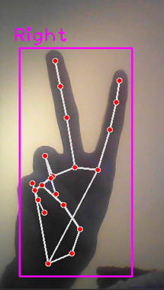
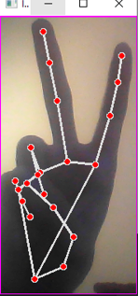
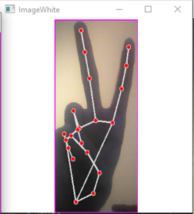
Data Sample

Slide 9
Model Selection and Training
Platform Used: Teachable Machines
Teachable Machines is a web-based tool developed by Google that allows users to easily train machine learning models in the browser.
It provides a user-friendly interface for training models using a webcam and collecting data for various tasks, such as image classification and gesture recognition.
Platform uses CNN to train the model.
Model Training Parameters:
Epochs: Refers to the number of times the entire dataset is passed forward and backward through the neural network during training. Epochs = 150
Batch Size: Specifies the number of training examples utilized in one iteration. Batch size = 16
Learning Rate: Determines the size of the step taken during the optimization process to update the weights of the neural network. Learning Rate = 0.001
https://teachablemachine.withgoogle.com/

Slide 10
Model Format: keras.h5
After training is complete, the model is saved in the form of a keras.h5 file.
This file format is used to store a trained Keras model(.h5), including the model architecture and weights, allowing for easy deployment and reusability of the trained model.
The .h5 format stands for Hierarchical Data Format Version 5 which is designed for storing and organizing large amount of data.
Preview Option:
Teachable Machines provides a preview option to visualize and test the trained model's performance.
Users can see how the model classifies new input data in real-time, helping to evaluate its accuracy and effectiveness.

Slide 11
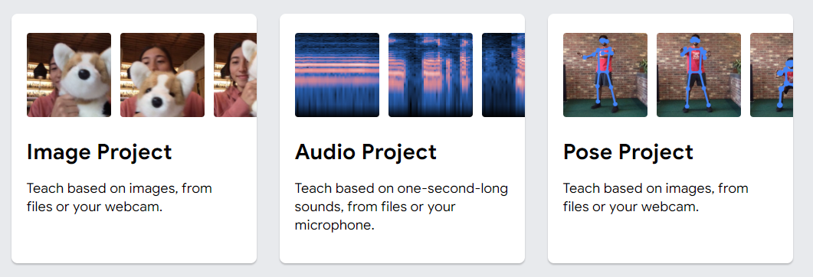
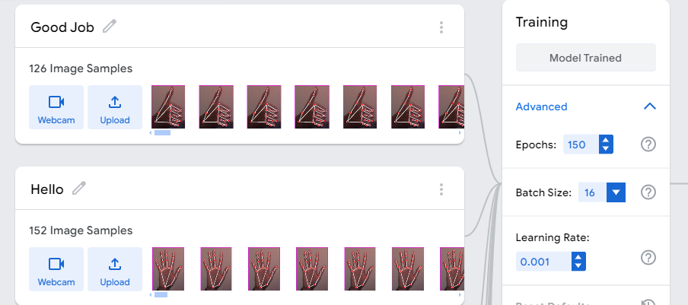
Teachable Machine

Slide 12
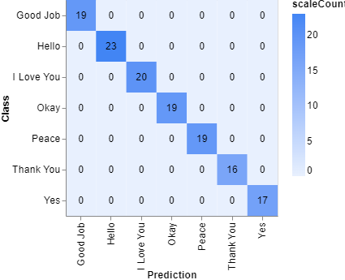
Testing Result
Confusion Matrix
The input dataset is divided into 80% for training and 20% for testing.
With this confusion matrix we get 100% accuracy.

Slide 13
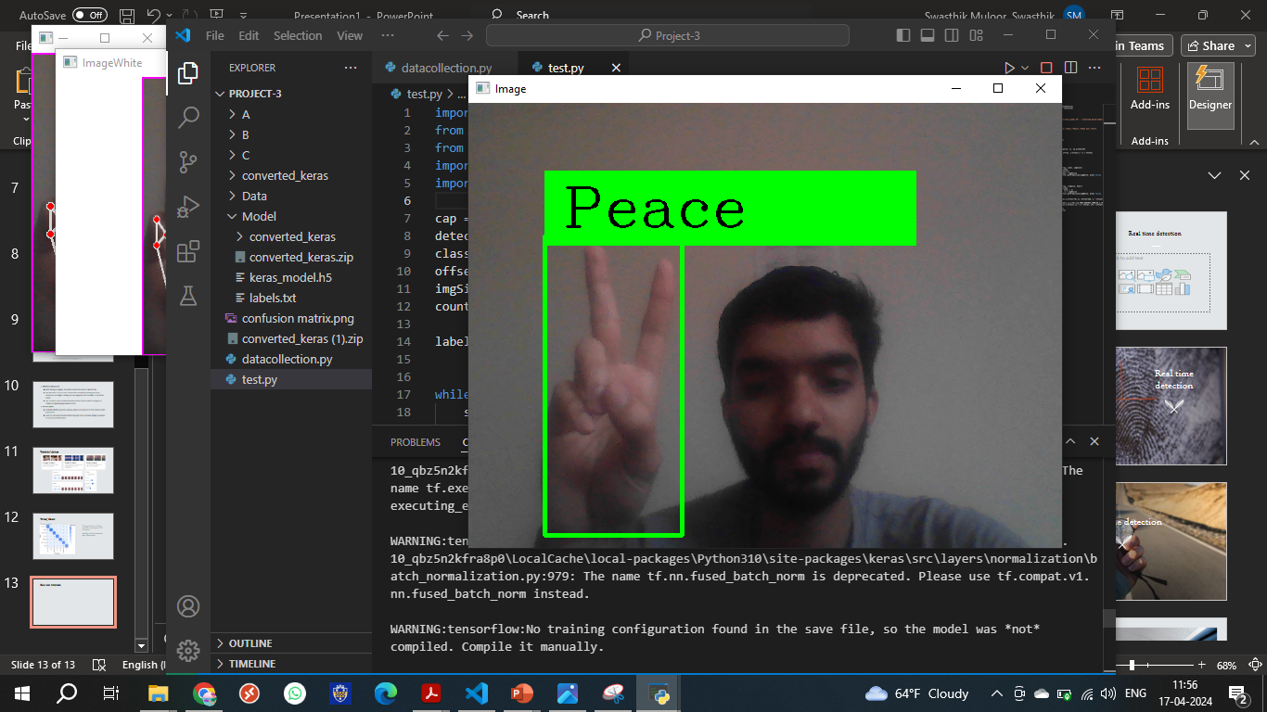
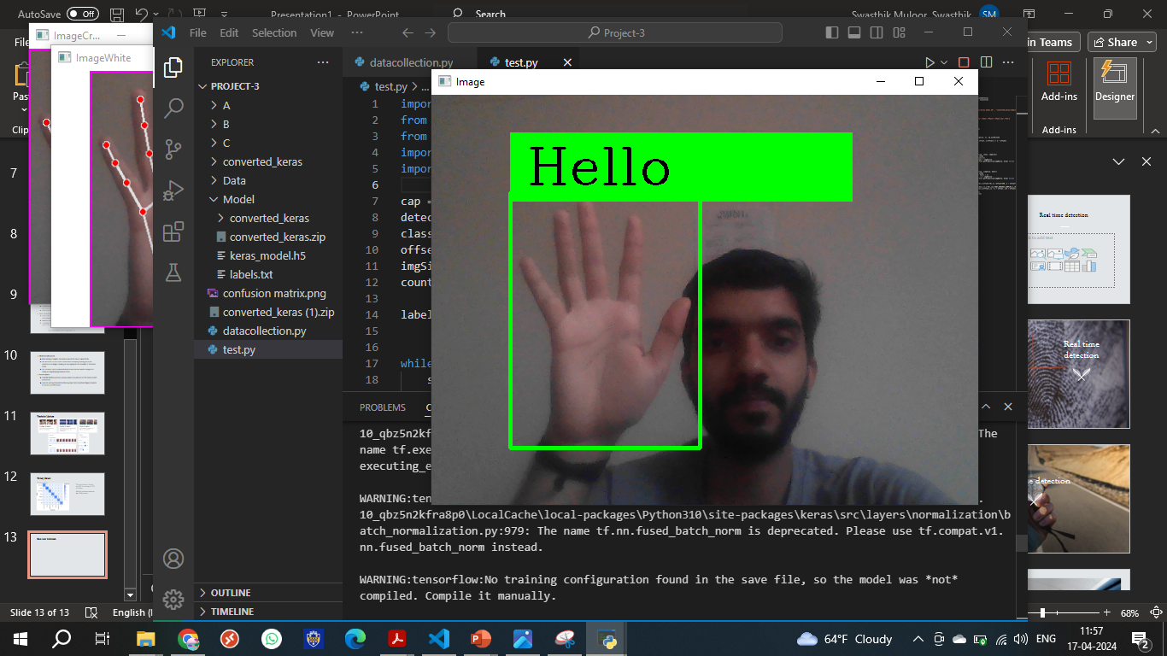
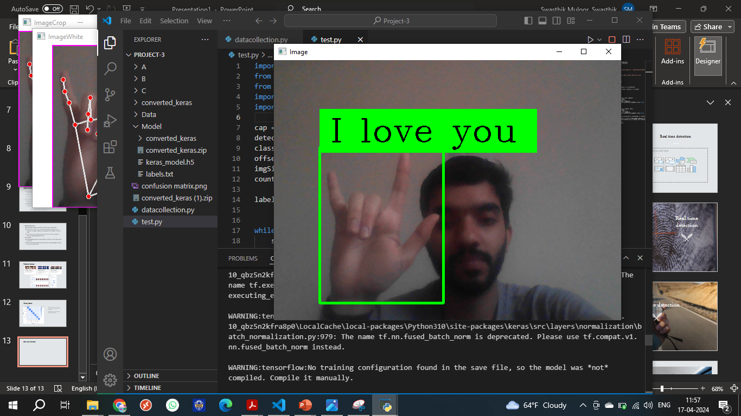
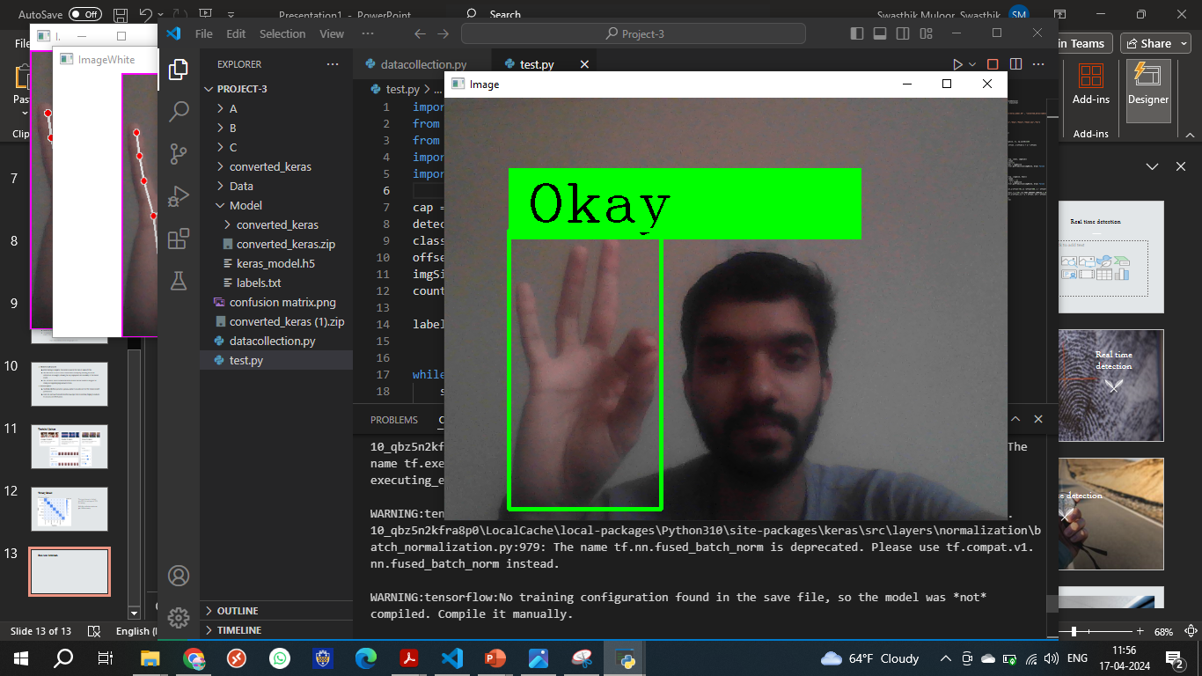
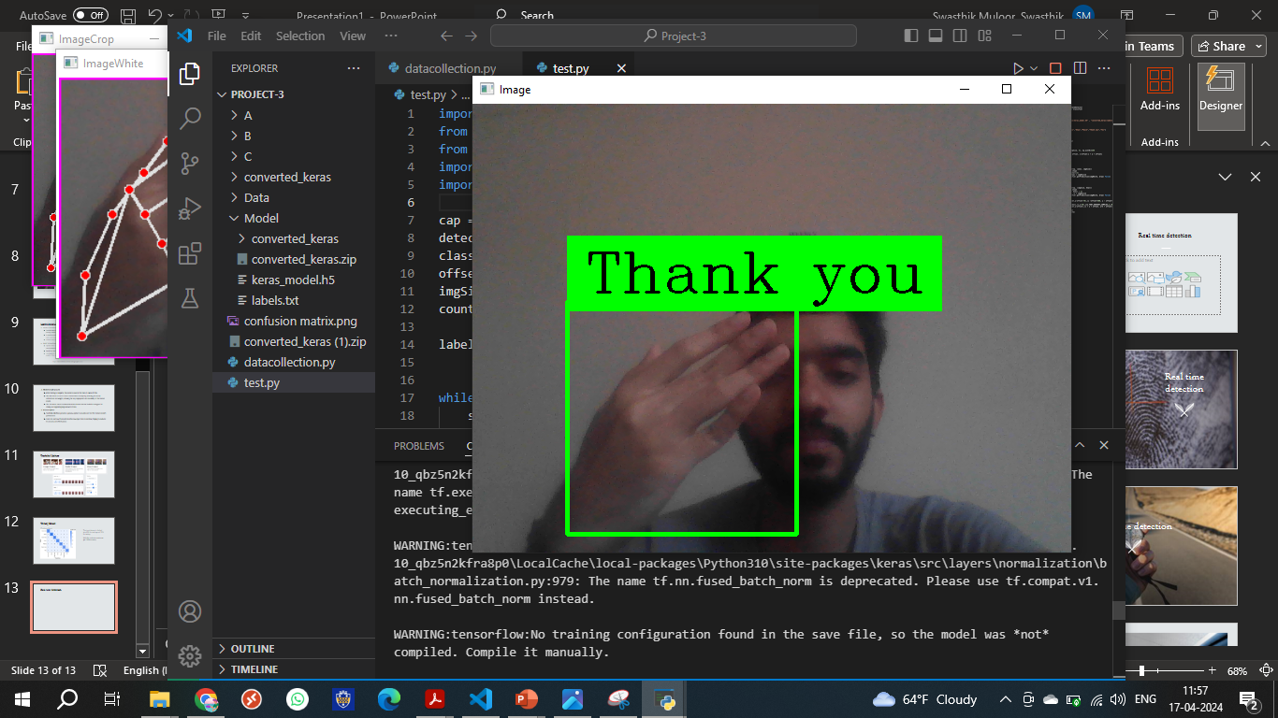
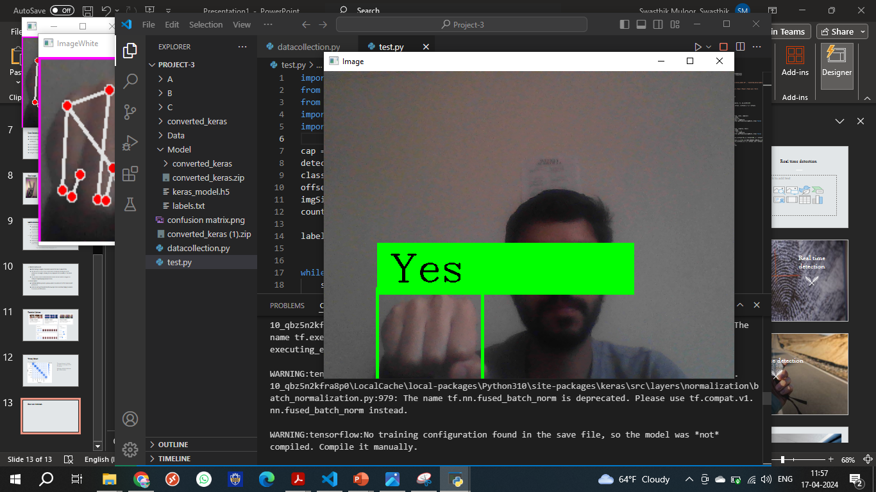
Real time detection

Slide 14
Thank You
Questions ?

